Slide 1
Aschaffenburg University of Applied Sciences

Slide 2
FACTS AND FIGURES

Slide 3
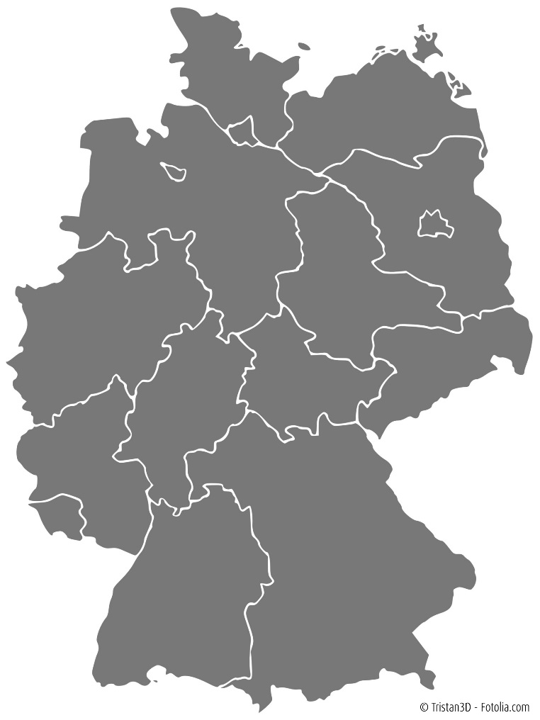
WHERE IS ASCHAFFENBURG LOCATED?
Approx. 70,000 inhabitants
Located in Central Germany, in Lower Franconia / Bavaria
40 km to Frankfurt/Main
350 km to Munich
Berlin
Frankfurt
Aschaffenburg
Munich

Slide 4
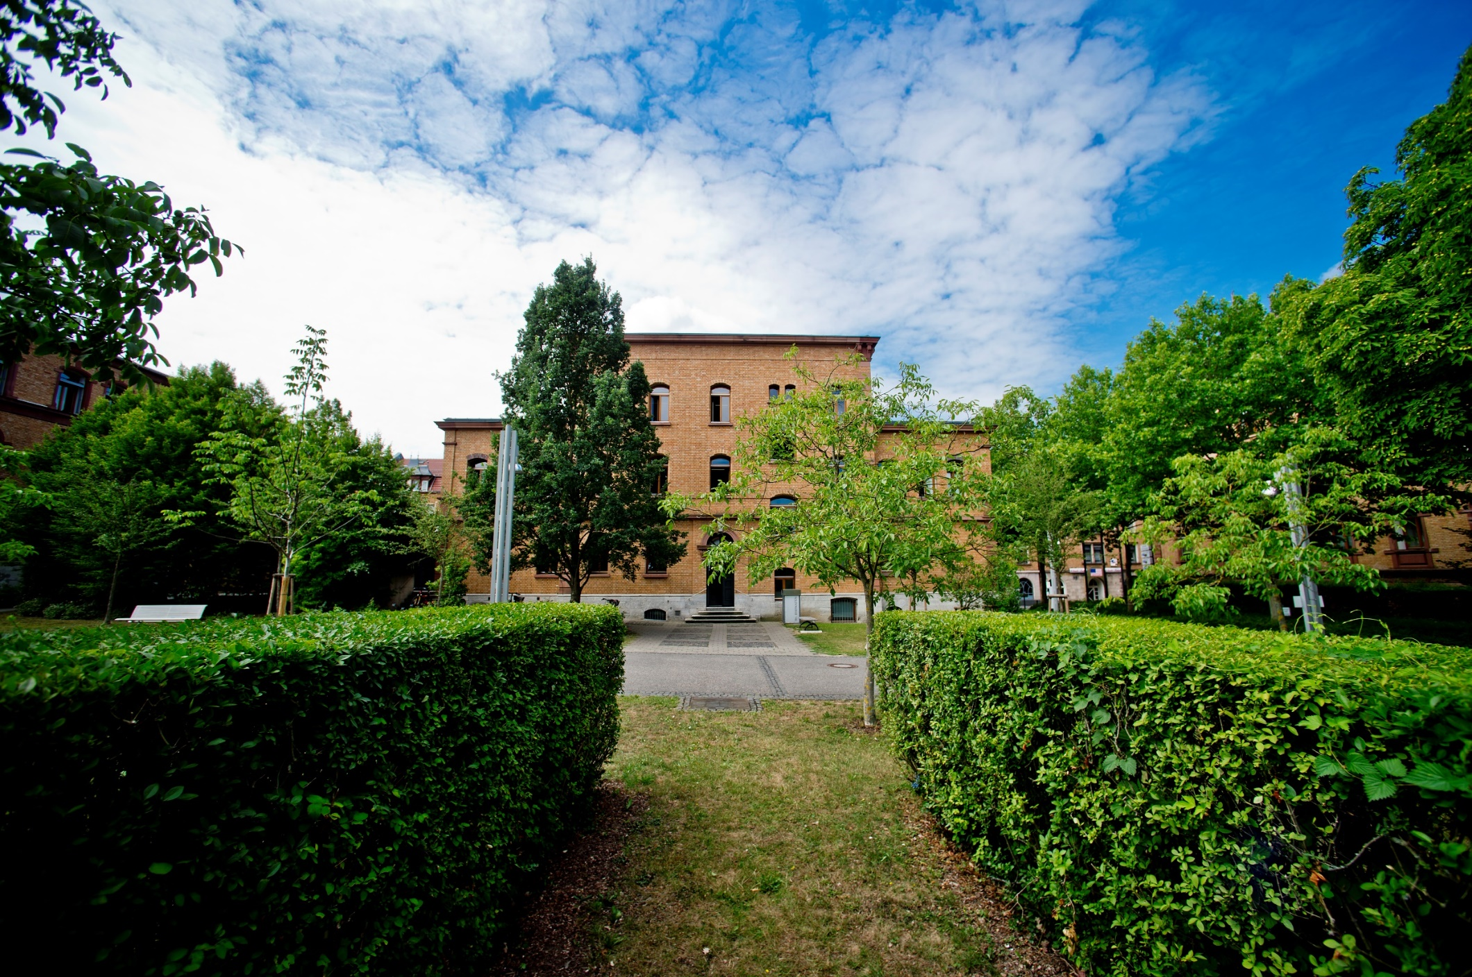
ASCHAFFENBURG UNIVERSITY OF APPLIED SCIENCES
Start of lectures in October 1995
Currently approx. 3,500 students
Technische Hochschule Aschaffenburg since March 2019
The designation „Technical University of Applied Sciences“ is reserved only for a select number of universities of applied sciences in Bavaria.
In a sense, it represents a quality feature.
Notes:
Technische Hochschule Aschaffenburg since March 2019 („technical university“; English name stayed the same)
In a sense, it represents a quality feature: it is a reflection of the quality of our research, the ever increasing amount of third-party funds acquired, quality and number of publications, growing number of cooperative doctoral candidates, in particular in the engineering sciences.

Slide 5
WHAT MAKES US UNIQUE?
Top-ranked programmes
Historical and modern campus
Small groups – target-oriented studying
State-of-the-art laboratory equipment
Please click on the icon for more
information on the German CHE ranking
Notes:
Walkable campus with a welcoming atmosphere: Our compact campus is easily walkable, and our small size creates a strong community feeling. On a typical day on campus, you might bump into friends on your way to class, eat lunch with a professor in the dining hall, carry out research with classmates in a high-tech laboratory, and stop by the Computer Centre to email with friends and family back home – all within a five- or ten-minute walk.
Excellence in teaching and personal support: Small class sizes mean that your professors and lecturers are available to you for extra guidance or support, both during and outside of seminars. Additionally, we offer extensive academic and general guidance services if you need support in any aspect of your life as a student.
Modern infrastructure, hi-tech facilities: Our classrooms, lecture halls, offices, and laboratories are housed in picturesque historical buildings that have been completely renovated in recent years in order to provide a modern, hi-tech study environment. Laboratory and workshop facilities are cutting-edge, offering you access to the latest equipment in your chosen field, and classrooms and study spaces are equipped with modern computing technology.

Slide 6
https://youtu.be/0SjmU8S1bio

Slide 7
EXCHANGE AT AUAS

Slide 8
https://youtu.be/jTduVBjoZlM

Slide 9
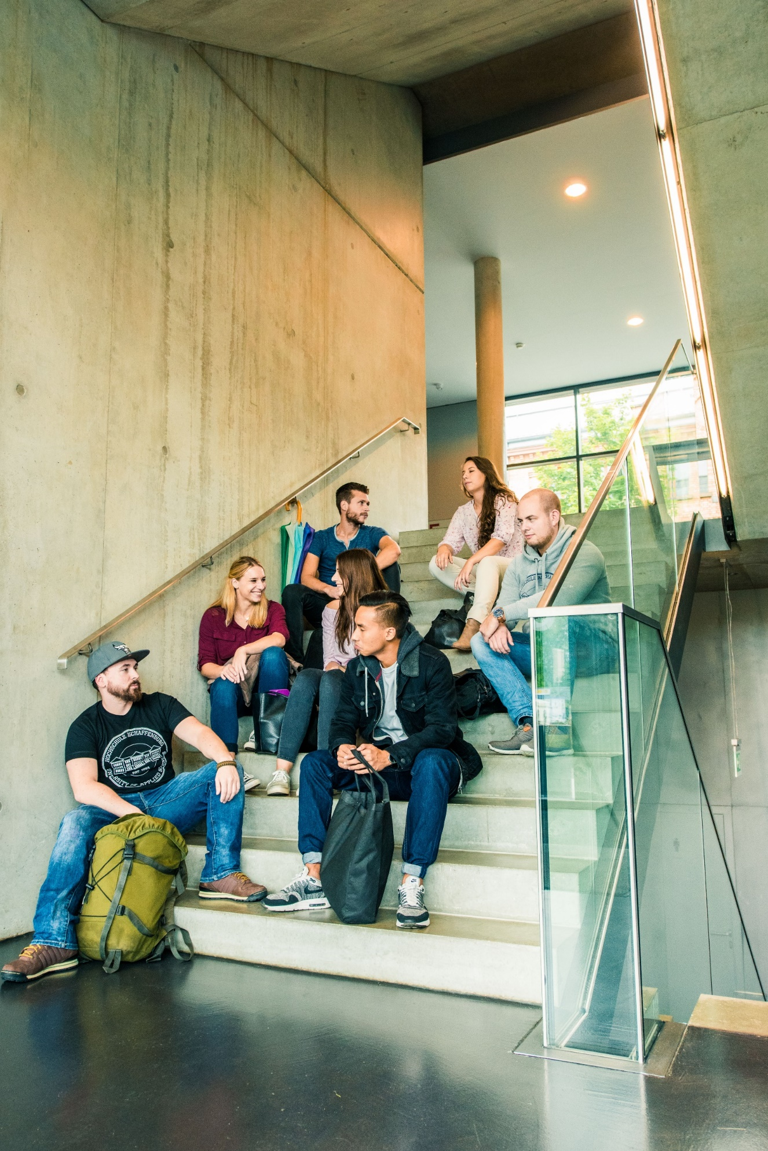
STUDYING AT ASCHAFFENBURG UAS
Three faculties:
Faculty of Business Administration and Law
Faculty of Engineering
Faculty of Health Sciences
Many modules offered in English
Regular modules taught in German
Virtual modules offered by vhb in English and German

Slide 10
SHORT-TERM PROGRAMMES
German Intensive Programmes
International Project Week
Global Master School
International Language Week
Flying faculty / tailor-made programmes

Slide 11
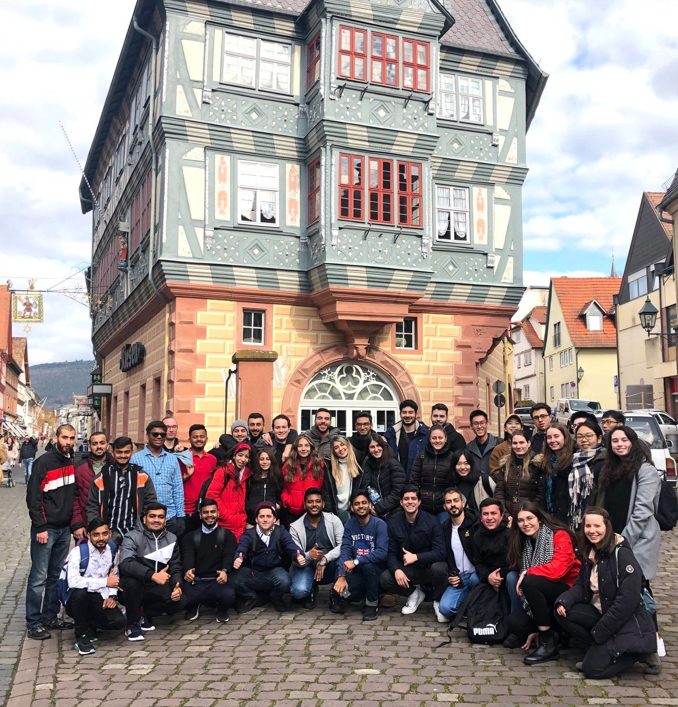
SOCIAL PROGRAMME
Orientation Weeks: two weeks at the beginning of the semester
Welcome Evening
Information on student facilities and services
Old town walking tour
Different hikes and/or city trips
Intercultural training

Slide 12
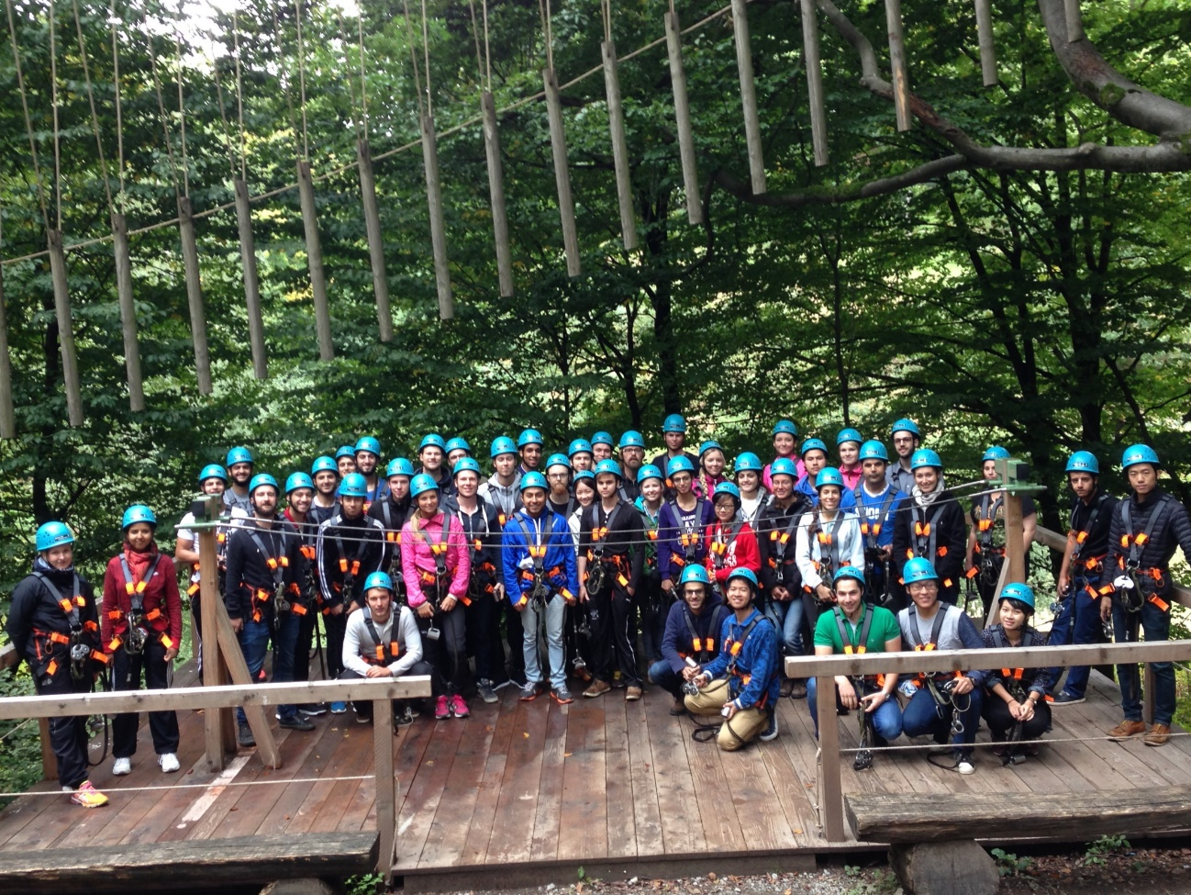
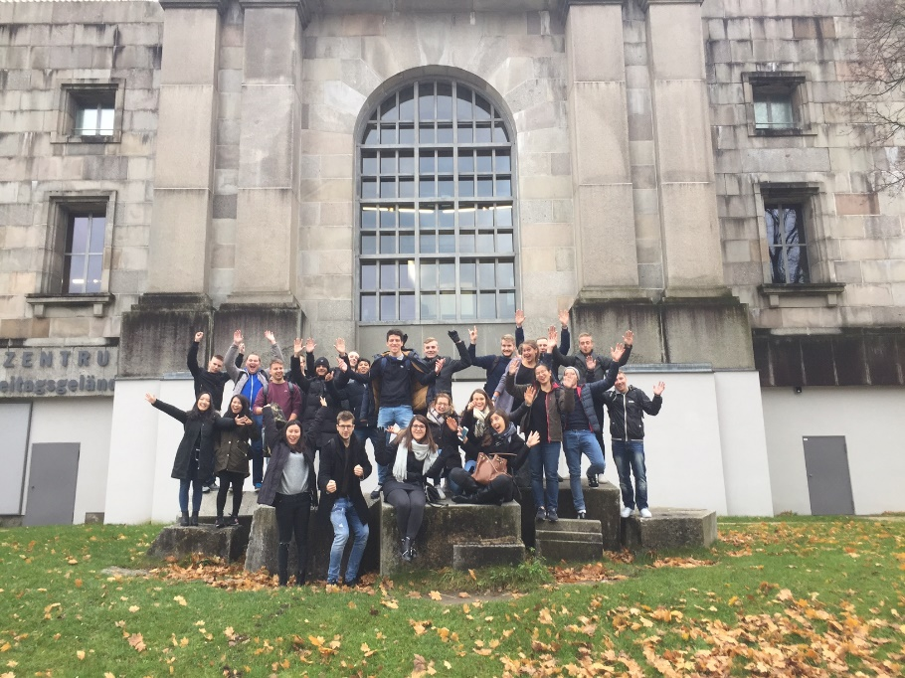
SOCIAL PROGRAMME
Buddy programme
Matched with a full-time student at Aschaffenburg UAS
Helps you to get settled in Aschaffenburg
Various social activities are offered by the buddies or International Office during the semester

Slide 13
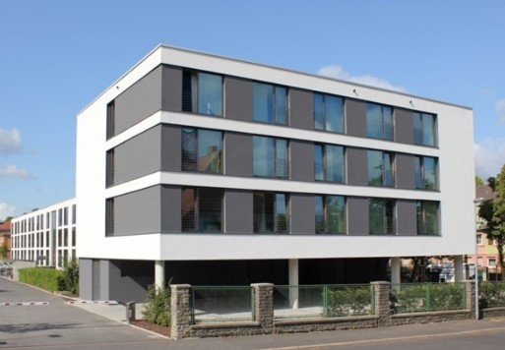
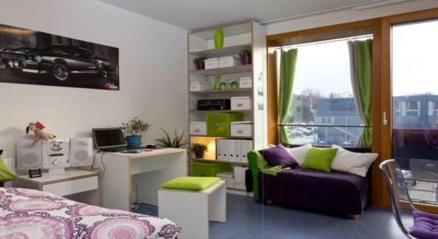
HALLS OF RESIDENCE ON CAMPUS
Administrated by Studentenwerk Würzburg (Student Welfare Organisation)
Comfortable flats at reasonable prices (approx. 280-380 EUR/month incl. Wi-Fi & utilities)
Accommodation for 270 students
Each apartment with its own kitchen & bathroom
Single and shared apartments available
Fitness and common rooms

Slide 14
HOW TO GO ON EXCHANGE TO AUAS?
Application
Semester Fee
www.th-ab.de/apply-online
60 EUR service fee
Nomination
Letter of Acceptance
Arrival
by your home university
→ Start preparing for your arrival
in Aschaffenburg

Slide 15
CONTACT INFORMATION
Aschaffenburg University of Applied Sciences
Head of International Office
Ernst Schulten
ernst.schulten@th-ab.de
+ 49 6021 / 4206-714
Incoming Coordinator
Carina Blaeser, Barbara Powollik
incoming@th-ab.de
+ 49 6021 / 4206-850 or -544
Erasmus+ Institutional Coordinator
Maique Gaspar Dos Santos, Nina Parche
erasmus@th-ab.de
+ 49 6021 / 4206-697
Outgoing Coordinator
Bettina Arnold, Jessica Albert
international@th-ab.de
+ 49 6021 / 4206 - 741 or - 742
e
e
e
e

Slide 16
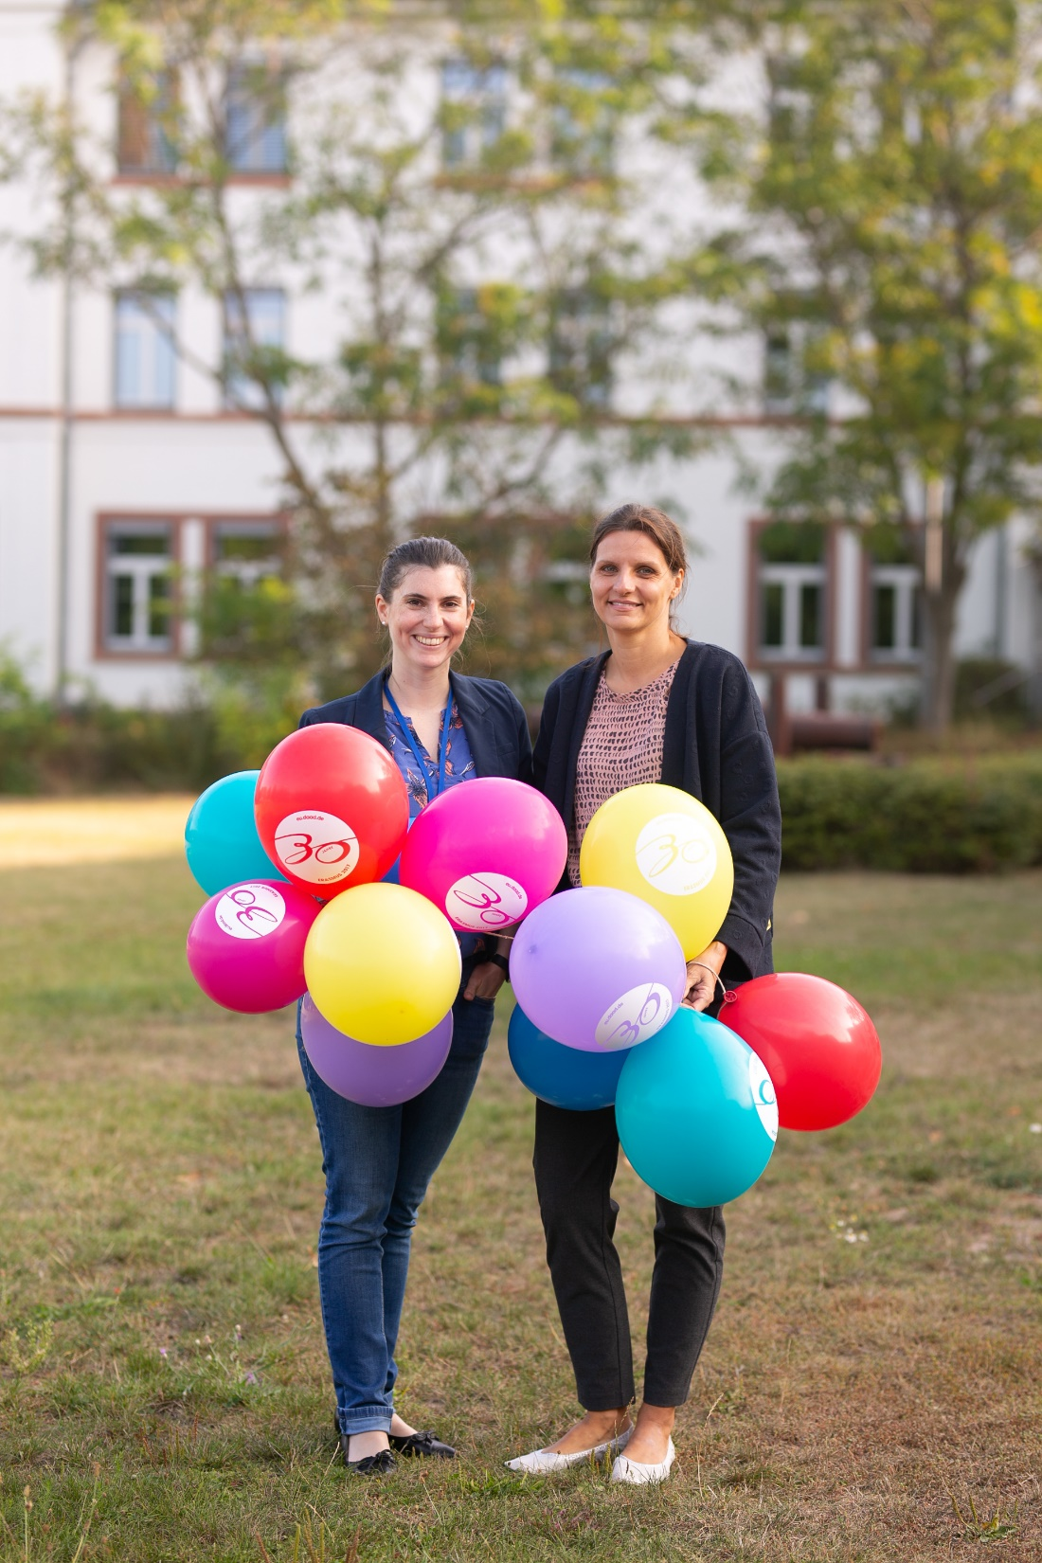
CONTACT INFORMATION
Aschaffenburg University of Applied Sciences - Incoming
+ 49 6021 / 4206-850 or -544
e
incoming@th-ab.de
https://www.facebook.com/thabinternational

Slide 17
Thank you.
Any questions?
We would be happy to answer them.

