Slide 1
Aschaffenburg University of Applied Sciences
Summer Semester 2023

Slide 2
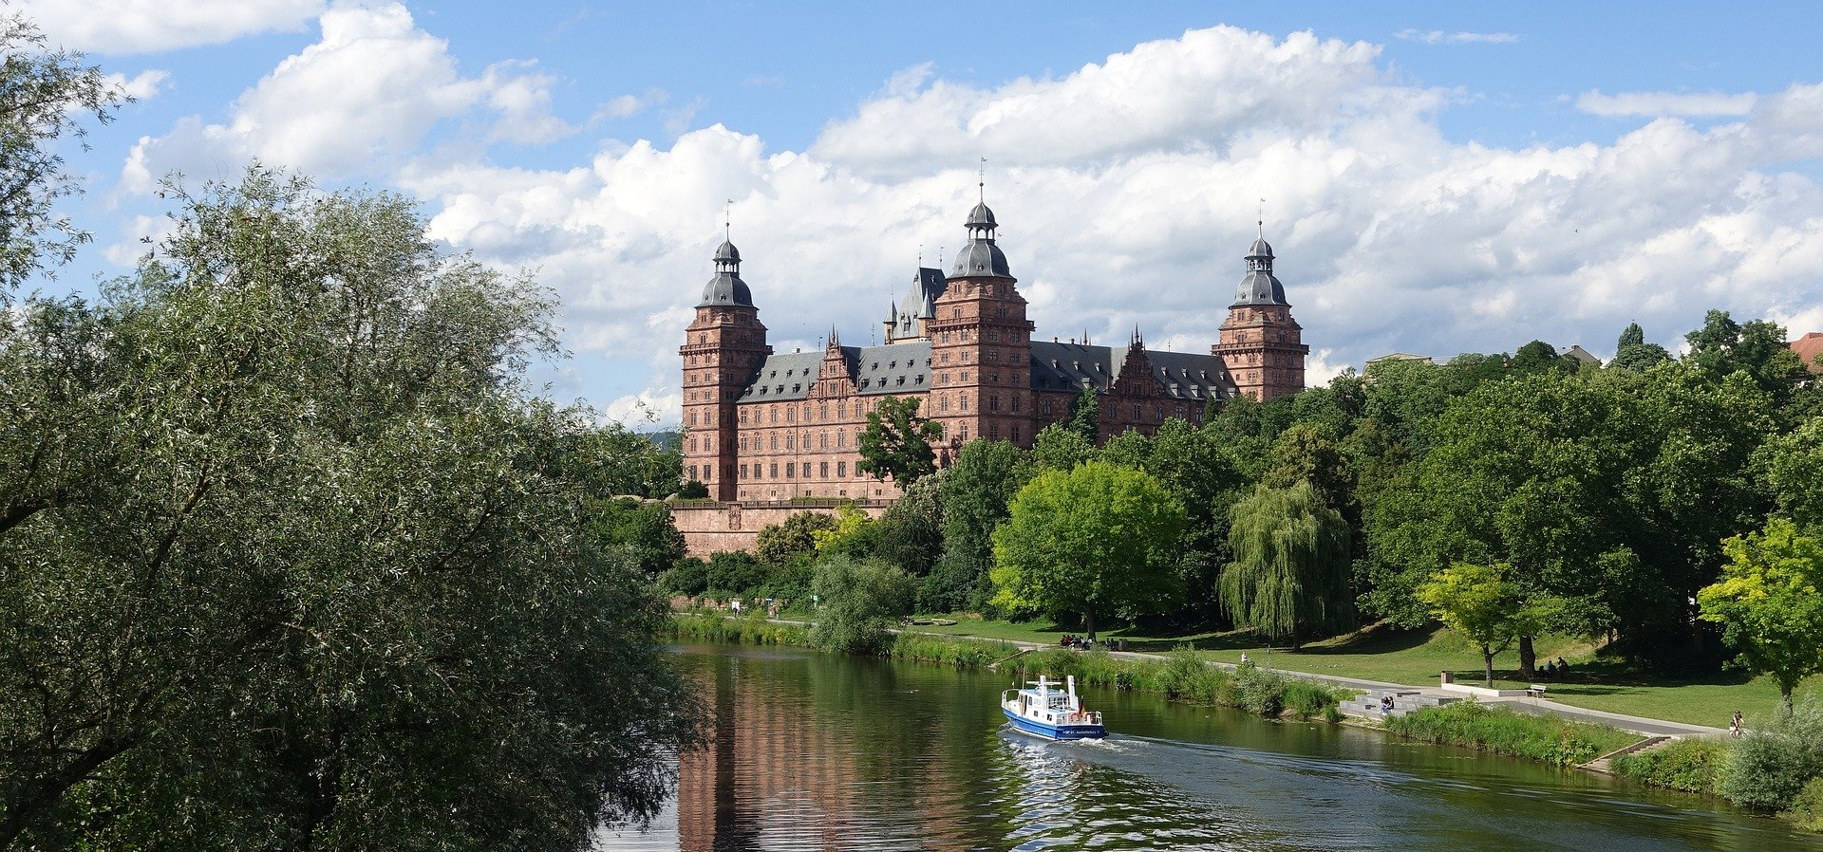
FACTS AND FIGURES

Slide 3
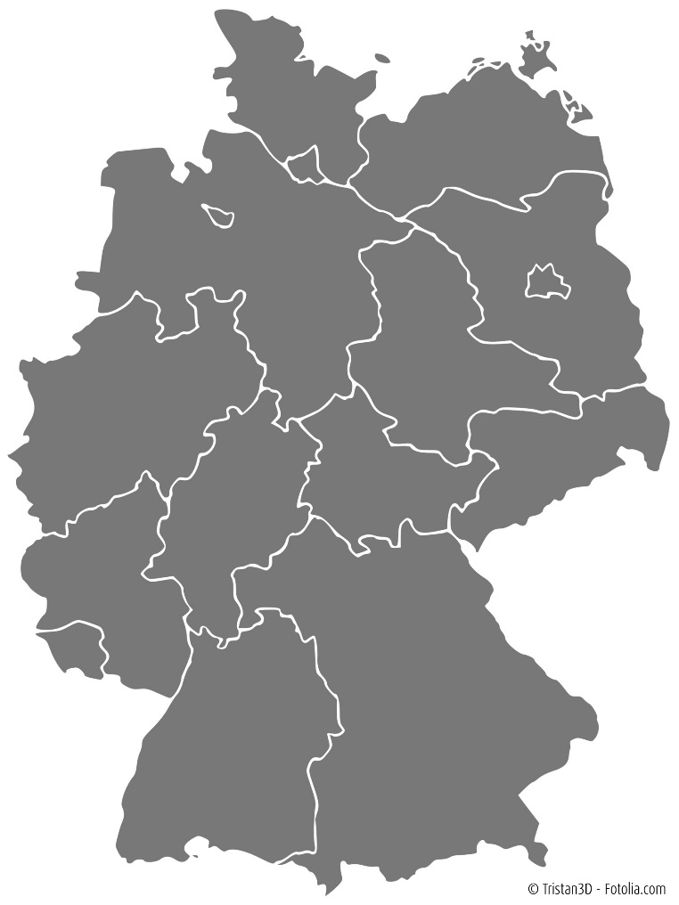
WHERE IS ASCHAFFENBURG LOCATED?
Approx. 70,000 inhabitants
Located in Central Germany, in Lower Franconia / Bavaria
40 km to Frankfurt/Main
350 km to Munich
Berlin
Frankfurt
Aschaffenburg
Munich

Slide 4

https://youtu.be/5rcfqOVZrpU

Slide 5
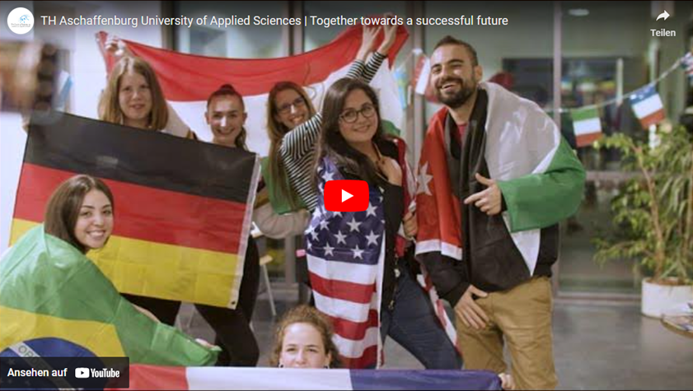
https://youtu.be/5rcfqOVZrpU

Slide 6
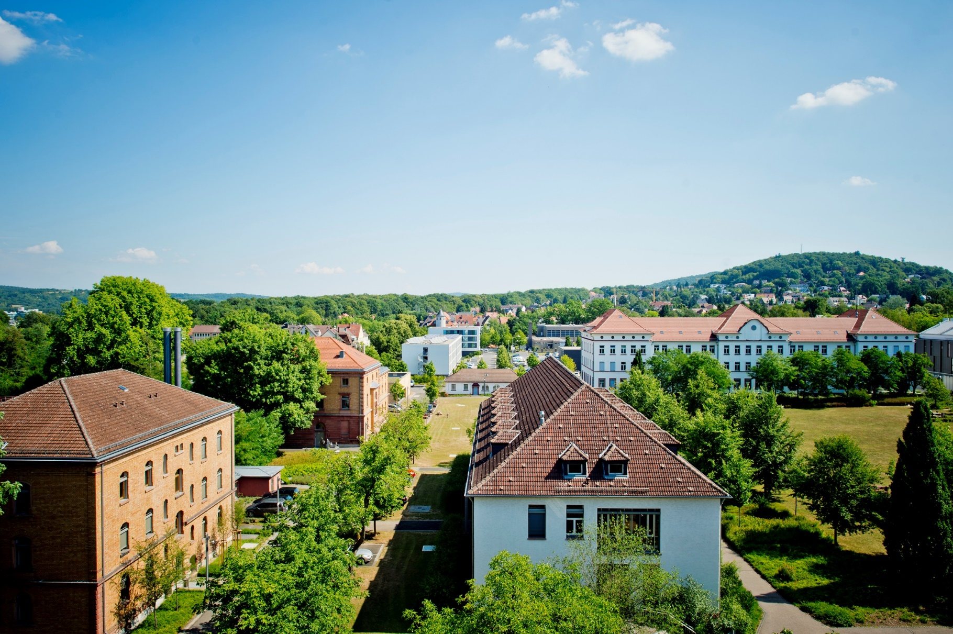
ASCHAFFENBURG UNIVERSITY OF APPLIED SCIENCES
Start of lectures in October 1995
Currently approx. 3,200 students
Technische Hochschule Aschaffenburg since March 2019
  The designation „Technical University of Applied Sciences“ is reserved only for a select number of universities of applied sciences in Bavaria.
  In a sense, it represents a quality feature.
Notes:
Technische Hochschule Aschaffenburg since March 2019 („technical university“; English name stayed the same)
In a sense, it represents a quality feature: it is a reflection of the quality of our research, the ever increasing amount of third-party funds acquired, quality and number of publications, growing number of cooperative doctoral candidates, in particular in the engineering sciences.

Slide 7


WHAT MAKES US UNIQUE?
Top-ranked programmes
Historical and modern campus
Small groups – target-oriented studying
State-of-the-art laboratory equipment
Please click on the icon for more
information on the German CHE ranking
Notes:
Walkable campus with a welcoming atmosphere: Our compact campus is easily walkable, and our small size creates a strong community feeling. On a typical day on campus, you might bump into friends on your way to class, eat lunch with a professor in the dining hall, carry out research with classmates in a high-tech laboratory, and stop by the Computer Centre to email with friends and family back home – all within a five- or ten-minute walk.
Excellence in teaching and personal support: Small class sizes mean that your professors and lecturers are available to you for extra guidance or support, both during and outside of seminars. Additionally, we offer extensive academic and general guidance services if you need support in any aspect of your life as a student.
Modern infrastructure, hi-tech facilities: Our classrooms, lecture halls, offices, and laboratories are housed in picturesque historical buildings that have been completely renovated in recent years in order to provide a modern, hi-tech study environment. Laboratory and workshop facilities are cutting-edge, offering you access to the latest equipment in your chosen field, and classrooms and study spaces are equipped with modern computing technology.

Slide 8
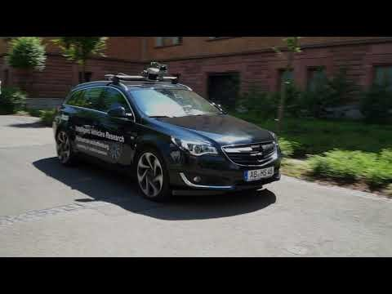
https://youtu.be/0SjmU8S1bio

Slide 9
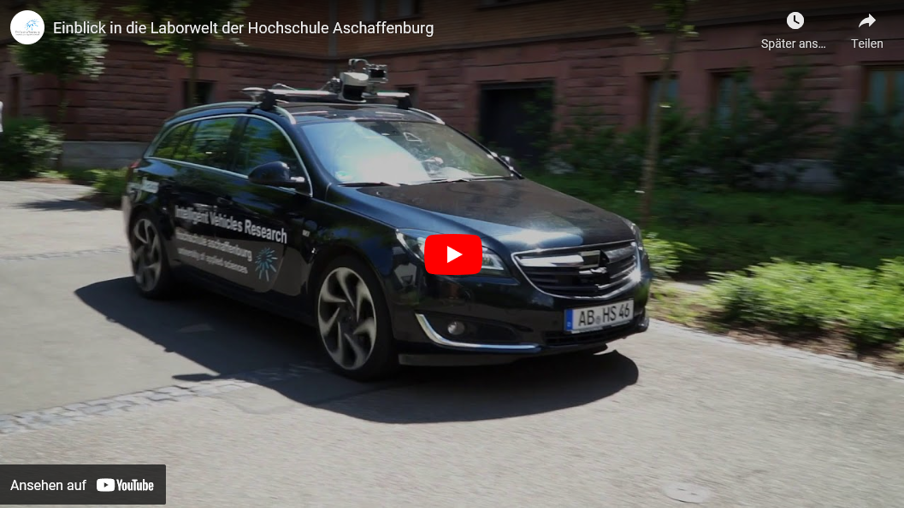
https://youtu.be/0SjmU8S1bio

Slide 10
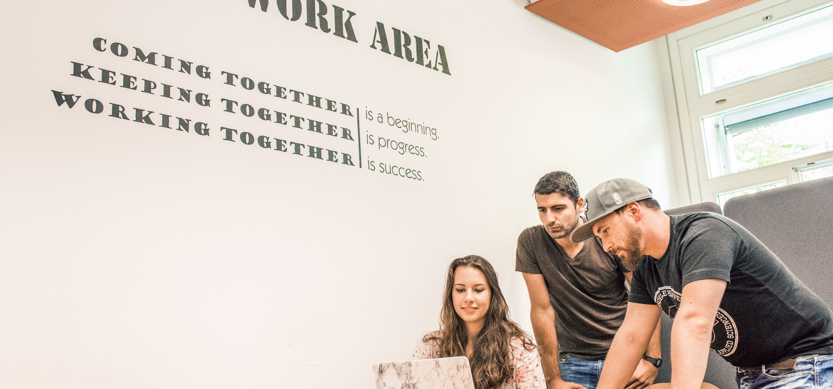
EXCHANGE AT AUAS

Slide 11

https://youtu.be/Nw4R5vSd0cI

Slide 12
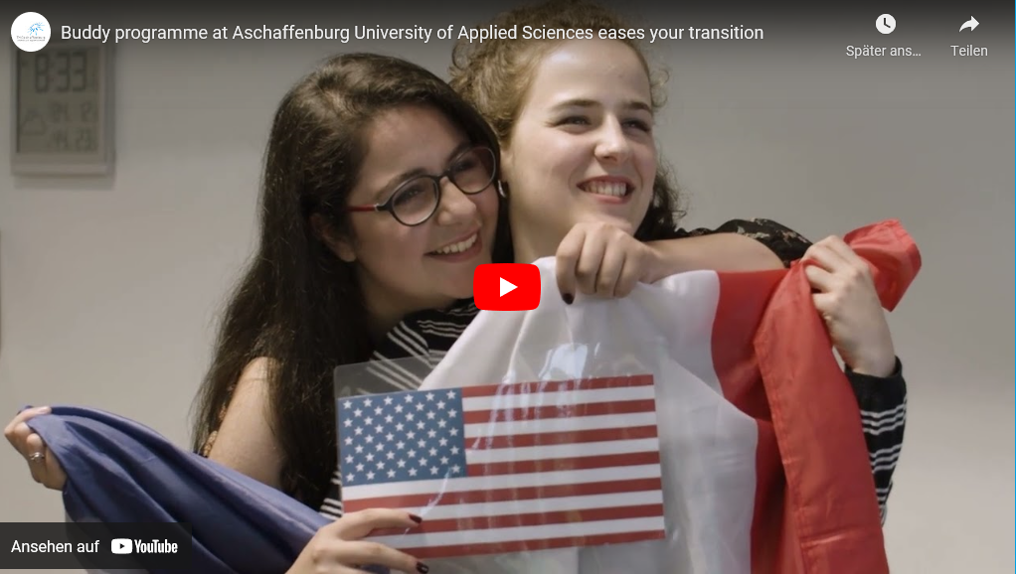
https://youtu.be/Nw4R5vSd0cI

Slide 13
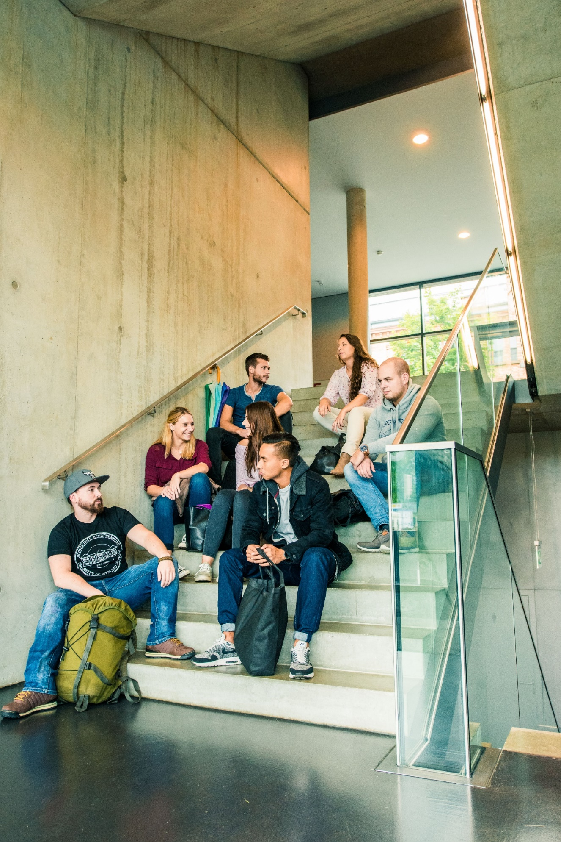
STUDYING AT ASCHAFFENBURG UAS
Three faculties:
  Faculty of Business and Law
  Faculty of Engineering
  Faculty of Health Care (in foundation)
Many modules offered in English
Regular modules taught in German

Slide 14
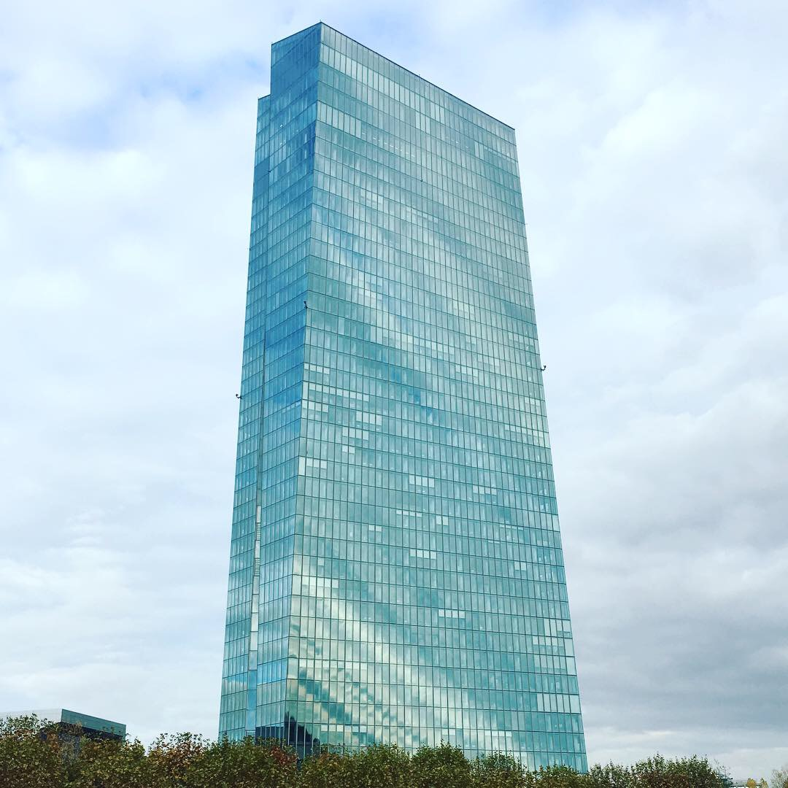
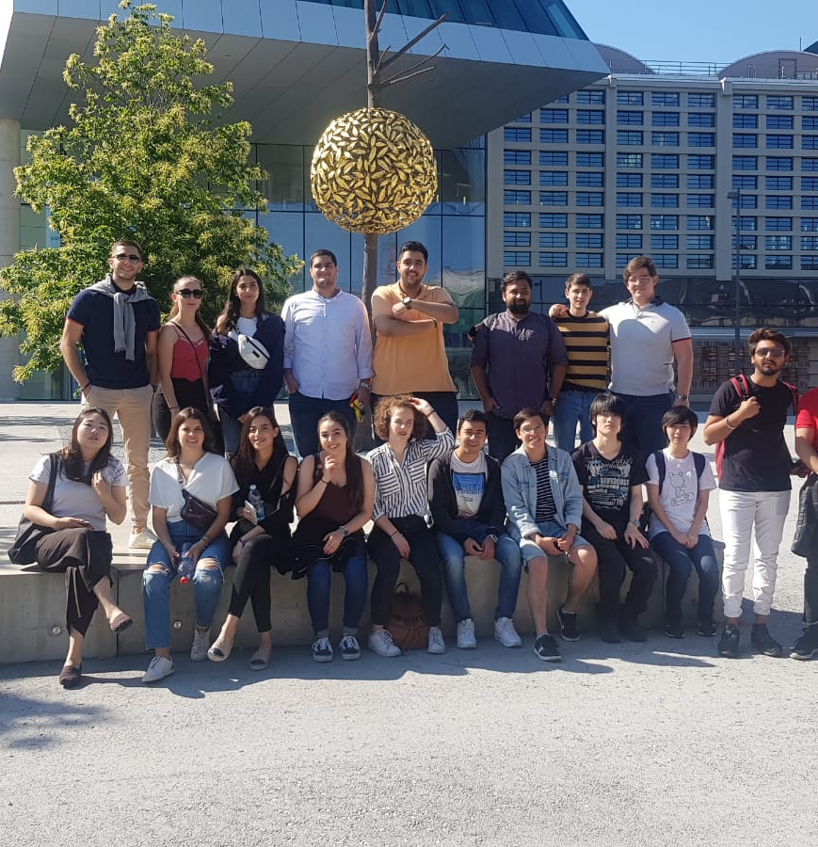
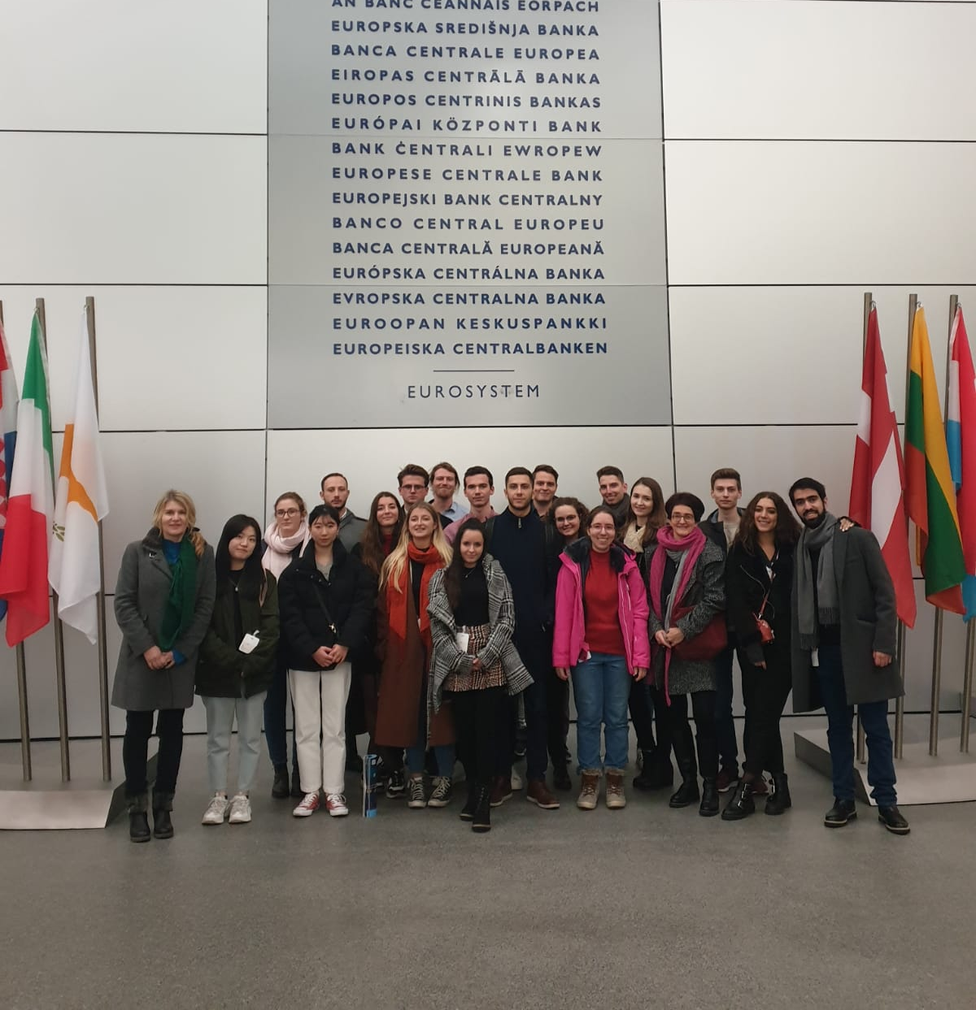
MODULE: INTRODUCTION TO THE EUROPEAN UNION
Main objective of the course: to introduce students to a basic understanding of the EU and its major actors and decision making processes, shaping the context business in the EU is operating in
Built-in study trips to EU institutions in Brussels and to the European Central Bank in Frankfurt

Slide 15
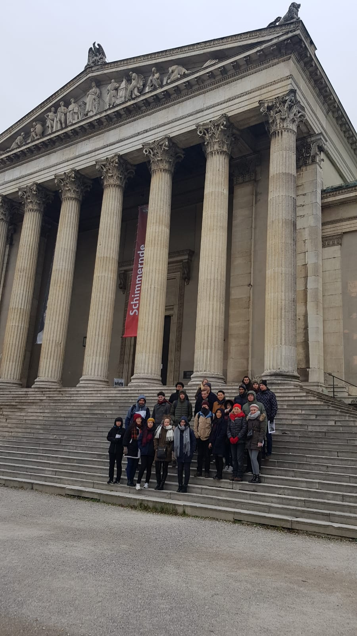
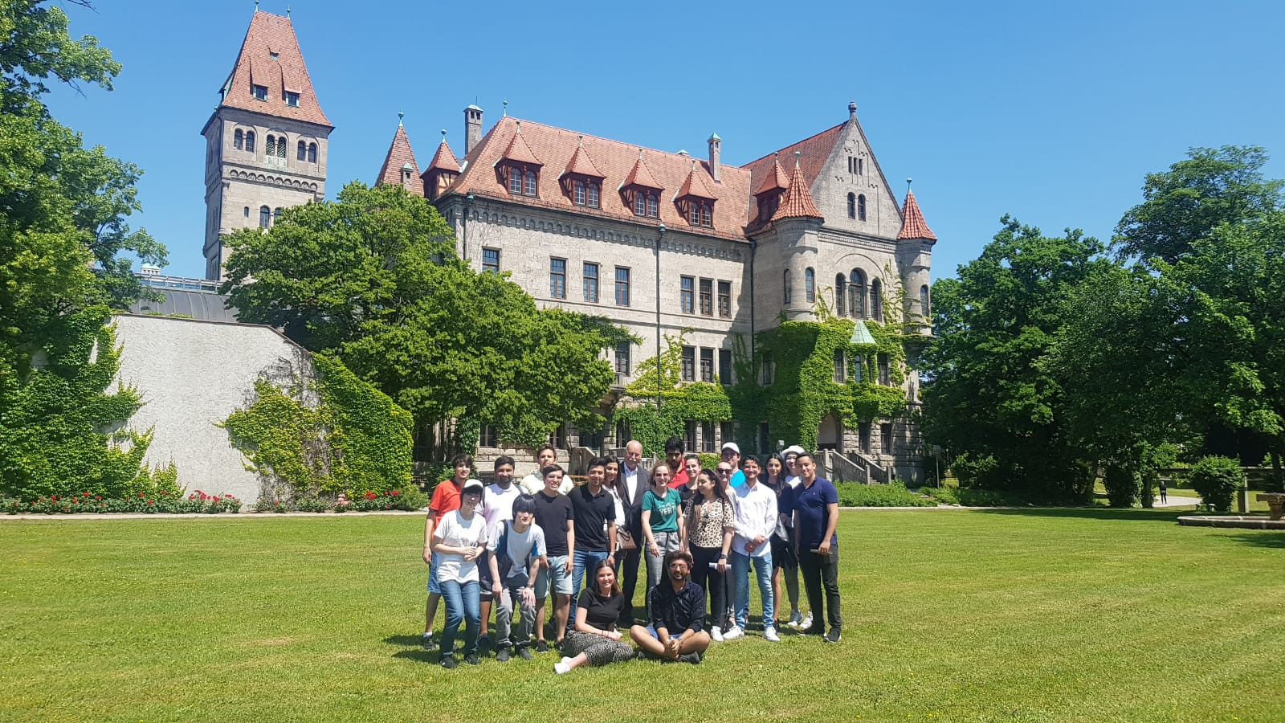
MODULE: BUSINESS SEMINAR GERMANY
Main objective of the course: to give an overview of current business-related issues of Germany's culture and society
Built-in study trips to nearby cities and major German companies, e.g. in Munich and/or Nuremberg.

Slide 16
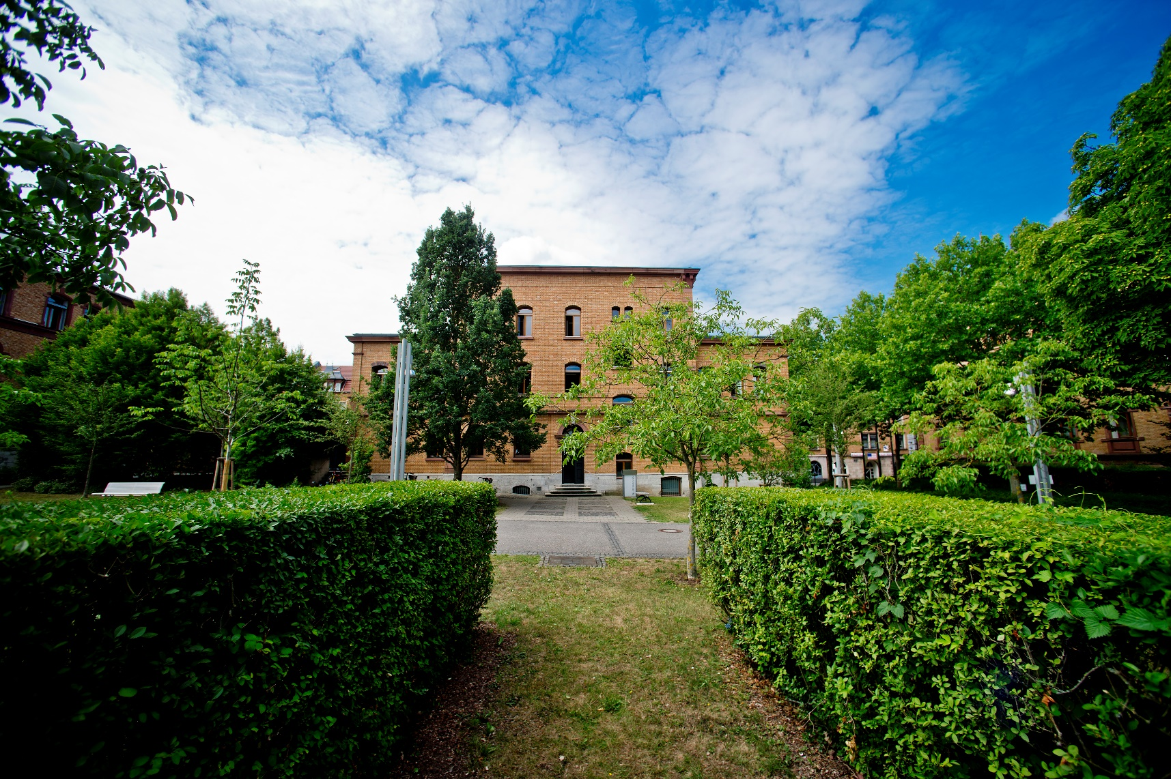
SHORT-TERM PROGRAMMES
German Intensive Programmes
Global Master School
International Project Week
International Language Week
International Summer School Programme

Slide 17
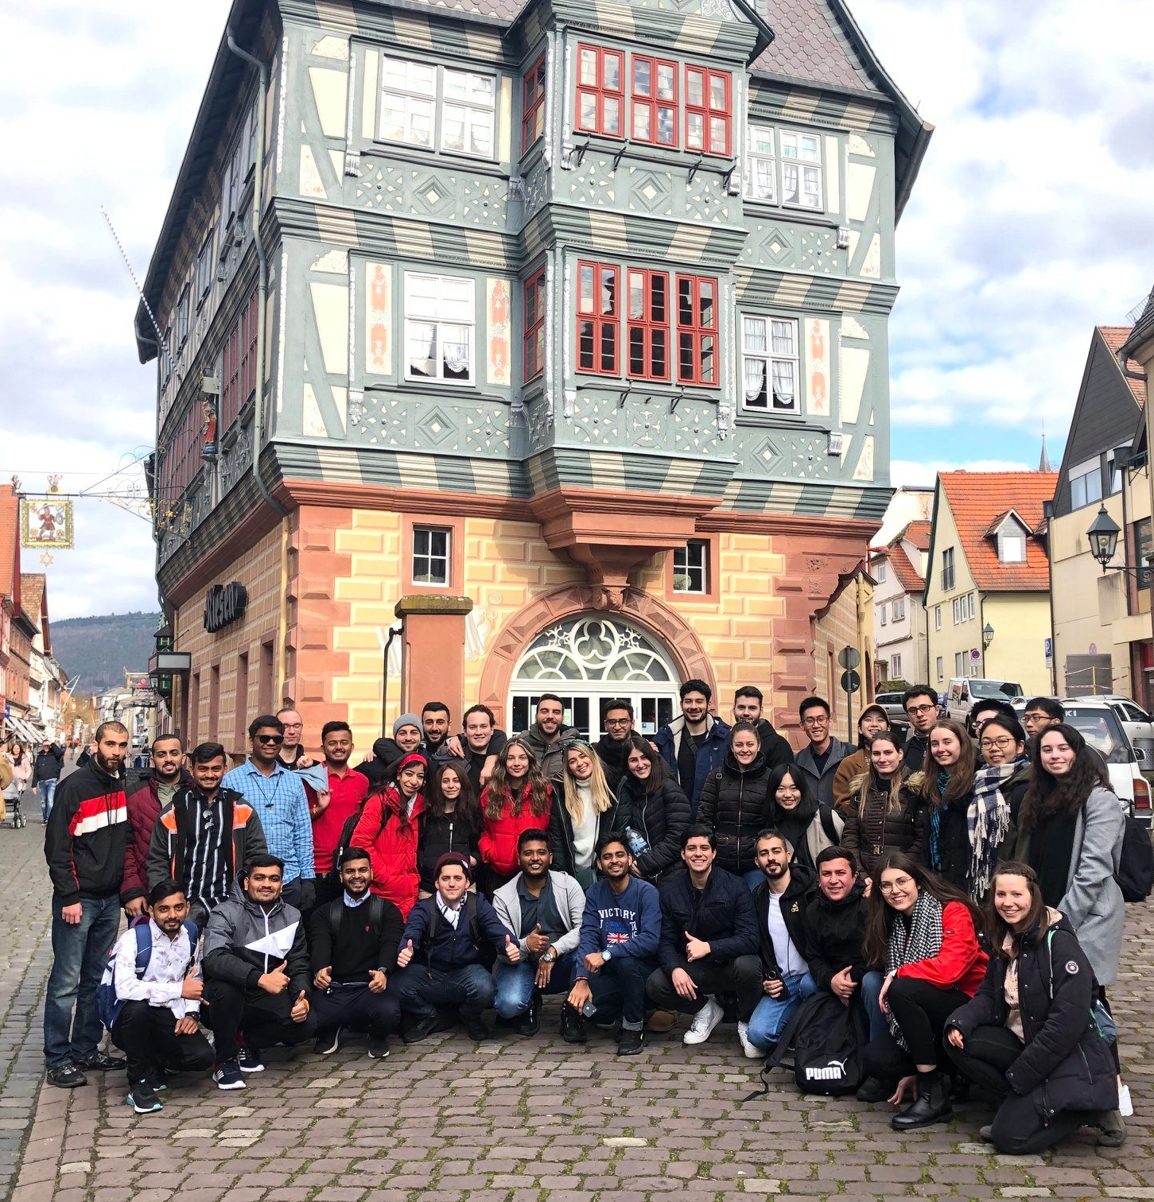
SOCIAL PROGRAMME
Orientation Weeks: two weeks at the beginning of the semester
  Welcome Evening
  Information on student facilities and services
  Old town walking tour
  Different hikes and/or city trips
  Intercultural training

Slide 18



SOCIAL PROGRAMME
  Buddy programme
    Matched with a full-time student at Aschaffenburg UAS
    Helps you to get settled in Aschaffenburg
  Various social activities are offered by the buddies or the International Office during the semester

Slide 19
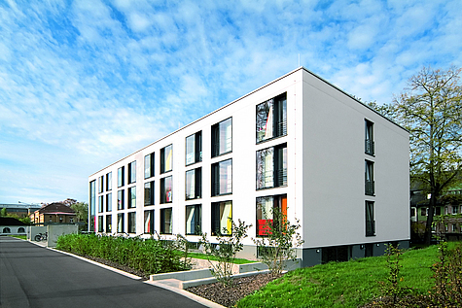
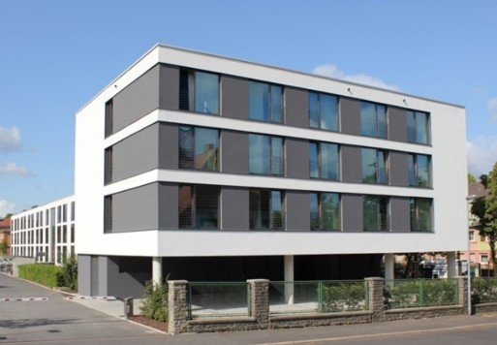
HALLS OF RESIDENCE ON CAMPUS
Administrated by Studentenwerk Würzburg
Comfortable flats at reasonable prices (approx. 280-380 EUR/month incl. Wi-Fi & utilities)
Accommodation for 270 students
Each apartment with its own kitchen & bathroom
Single and shared apartments available
Fitness and common rooms

Slide 20
HOW TO GO ON EXCHANGE TO AUAS?
Application
Semester Fee
www.th-ab.de/apply-online
60 EUR service fee
Nomination
Letter of Acceptance
Arrival
by your home university
→ Start preparing for your arrival
in Aschaffenburg

Slide 21

CONTACT INFORMATION
Aschaffenburg University of Applied Sciences
Incoming Coordinator
Carina Blaeser
    incoming@th-ab.de
+ 49 6021 4206-850
Faculty Coordinator for International Affairs
Prof. Dr. Alexandra Angress
Alexandra.Angress@th-ab.de
e
e
Student Assistant for International Affairs
Tamara Szabó
Tamara.Szabo@th-ab.de
e

Slide 22
CONTACT INFORMATION
Aschaffenburg University of Applied Sciences
Head of International Office
Ernst Schulten
  ernst.schulten@th-ab.de
  + 49 6021 / 4206-714
Incoming Coordinator
Carina Blaeser, Barbara Powollik
  incoming@th-ab.de
  + 49 6021 / 4206-850 or -544
Erasmus+ Institutional Coordinator
Maique Gaspar Dos Santos, Nina Parche
  erasmus@th-ab.de
  + 49 6021 / 4206-697 or -743
Outgoing Coordinator
Jessica Albert, Bettina Arnold
  international@th-ab.de
  + 49 6021 / 4206 - 742 or -741
e
e
e
e

Slide 23
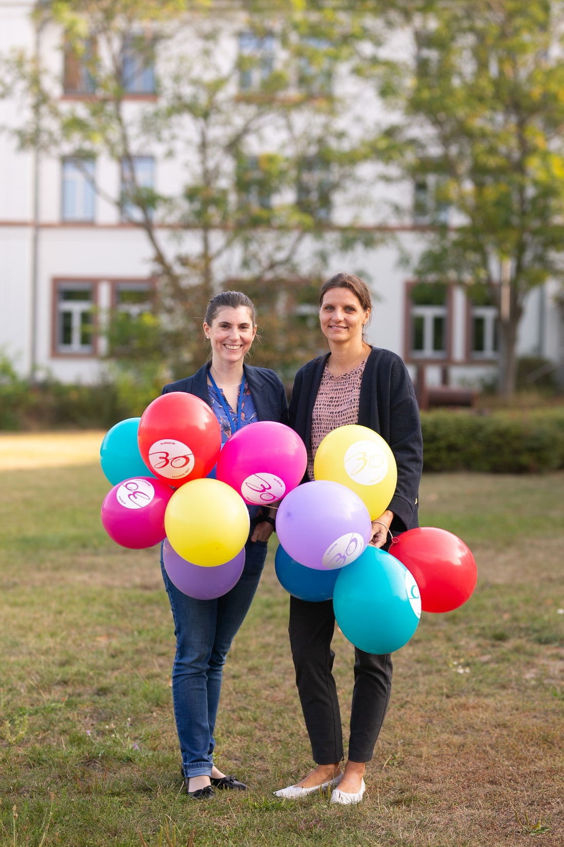

CONTACT INFORMATION
Aschaffenburg University of Applied Sciences - Incoming
+ 49 6021 / 4206-850 or -544
e
incoming@th-ab.de
www.instagram.com/thabinternational

Slide 24
Thank you.
Any questions?
We would be happy to answer them.

